Slide 1


Slide 2
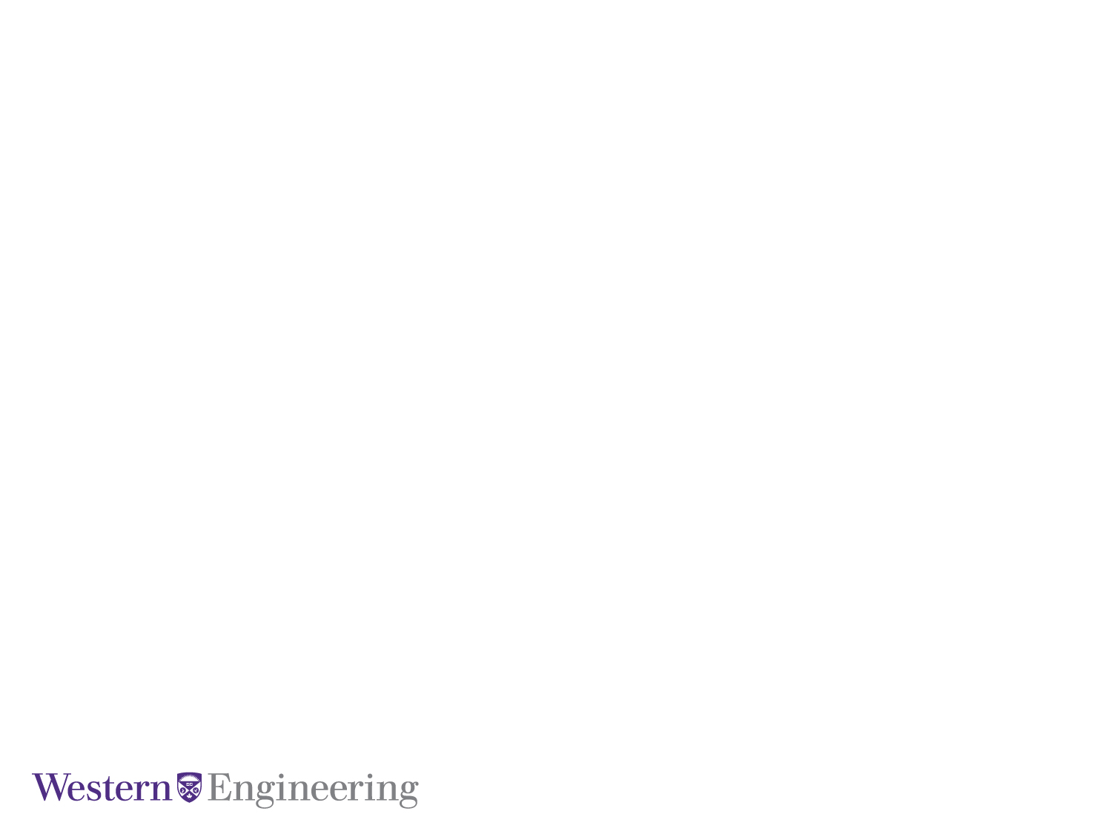
Integrating Explainability into Reinforcement Learning for Autonomous Vehicle Navigation in Simulated Environments
Fatemeh Dehrouyeh and Jifar Mekonnen
April 5, 2024

Slide 3
Overview
Lunar Lander
Autonomous vehicle context
DQN
A2C
PPO
RL is used to train the model
Explainability is added to model
SHAP

Slide 4
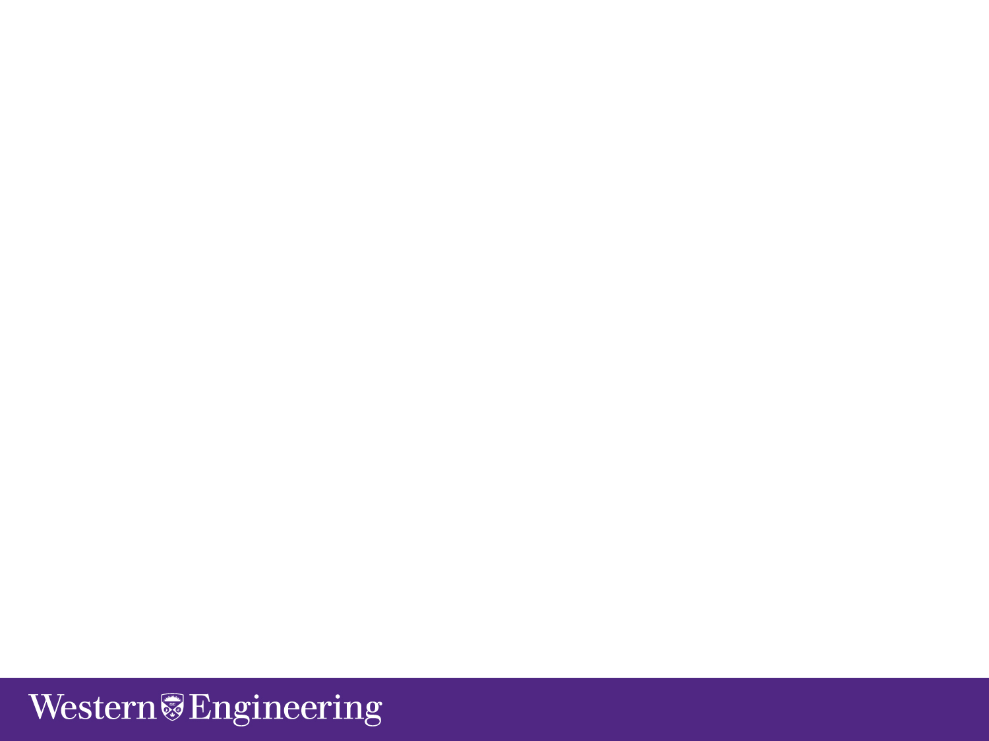




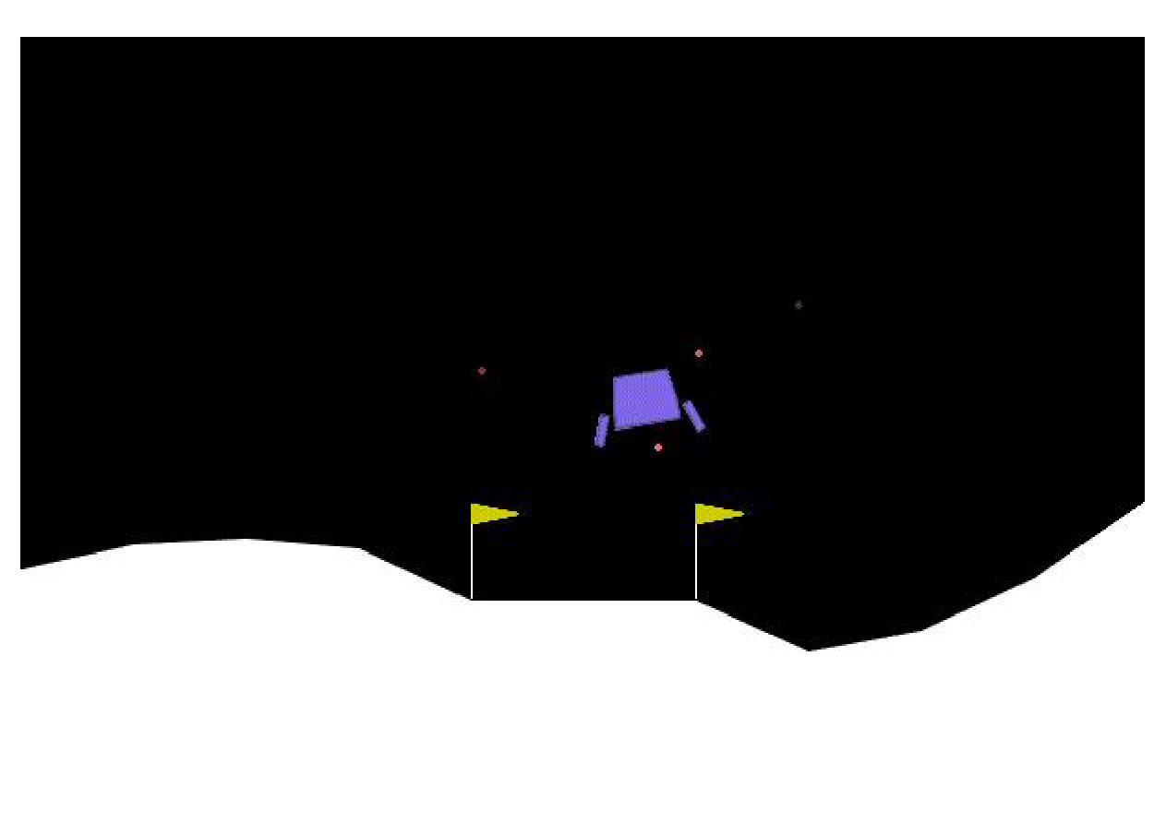

Lunar Lander Environment
Lunar-lander (from OpenAI gym Box2D)
Objective: Safely land a lunar vehicle on the moon within designated zones and avoid crashes.
Action space: 4 discrete actions
do nothing
fire left engine
fire main engine
fire right engine
Observation space: 8-d vector
$$(x, y, \frac{dx}{dt}, \frac{dy}{dt}, θ, ω, l1, l2)$$
Reward model:
+ : closer to pad, slower, leg in contact (+10), landing safely (+100)
- : further to pad, faster, tilting, firing side (-.03), firing main (-.3), crashing (-100)
Notes:
s

Slide 5
RL Models
DQN
gamma = 0.99
learning rate = 6.3e-4
batch size = 128
replay buffer size = 50000
A2C
gamma = 0.995
learning rate = 8.3e-4
PPO
gamma = 0.999
learning rate = 3e-4

Slide 6
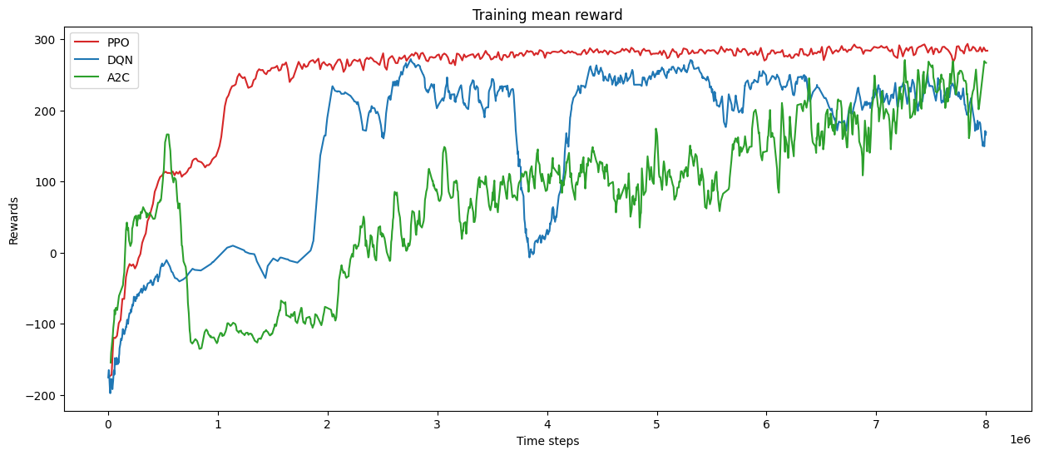
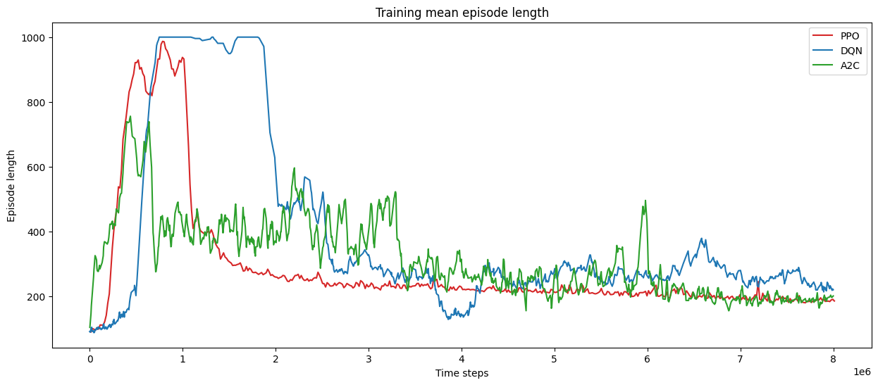
Training Results

Slide 7
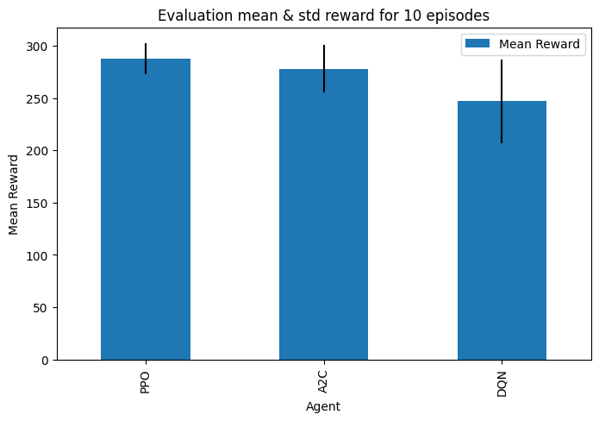
Evaluation Results

Slide 8
GIF Results
PPO
A2C DQN

Slide 9

Explainability
Input
Output
No black-box anymore!
More transparent ML outputs.
Scopes:
Global Interpretability clarify the entire logic of a model that leads to various outcomes.
Local Interpretability explains the rationale behind a specific decision.
SHapley Additive exPlanations (SHAP)

Slide 10
SHAP Background
SHAP is inspired by concepts from game theory.
Game: multiple players come together to achieve a certain outcome.
Game outcome when no players are present: refers to the baseline outcome before any of the players contribute.
Game outcome when all players are present: total value generated when all participants contribute to the game.
Shapley values: distributing the total payoff among the players.
considering all possible combinations of player participation to determine each player's marginal contribution to the game.

Slide 11
SHAP Algorithm
Baseline (E[f(X)])
(Background/Reference data)
Expected value of the model output over the dataset
500
Real Outcome (f(x))
Actual prediction made by the model for a specific observation
How much each feature contributes to moving the prediction from the baseline to the actual model output for a specific observation.
SHAP values of all the input features will always sum up to the difference between baseline (expected) model output and the current predicted output.

Slide 12
SHAP for RL
DQN
The goal of DQN is to learn a policy. It uses a neural network to approximate the Q-function (prediction of total reward).
In our XRL, maximum Q-value across all possible actions is achieved.
We are interested in calculating the importance of each feature toward the maximum Q-value.
A2C and PPO
In actor-critic algorithms, an actor decides which action to take, and a critic evaluates the taken action.
In our XRL, the value of the state (prediction of the expected returns from that state) is estimated by the critic as the output.
We are interested in calculating the importance of each feature toward the estimated state value.

Slide 13
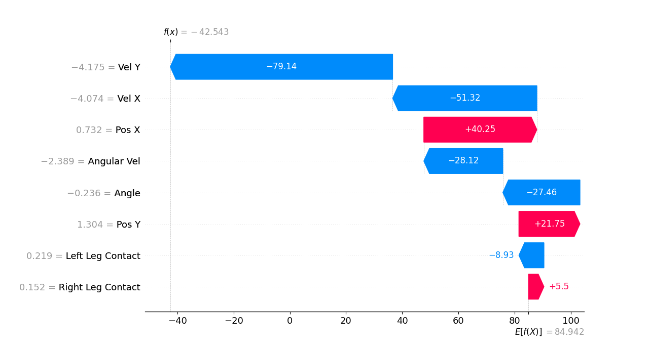
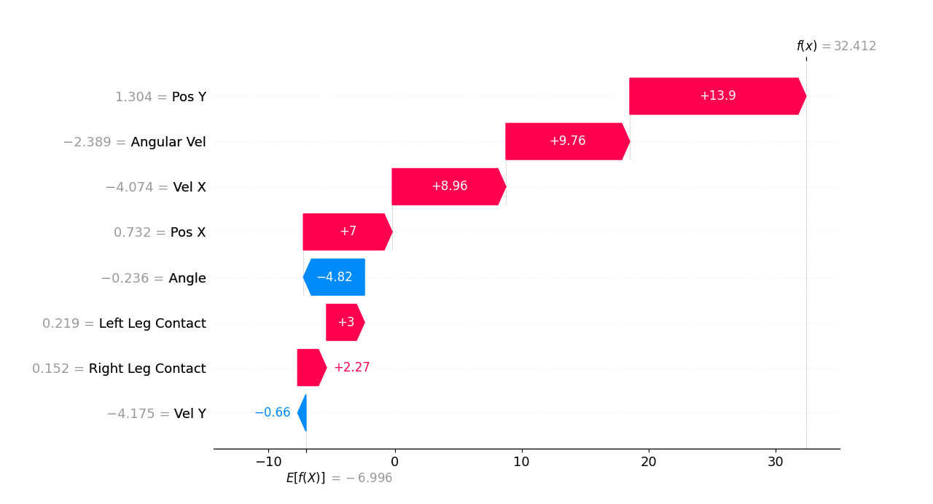
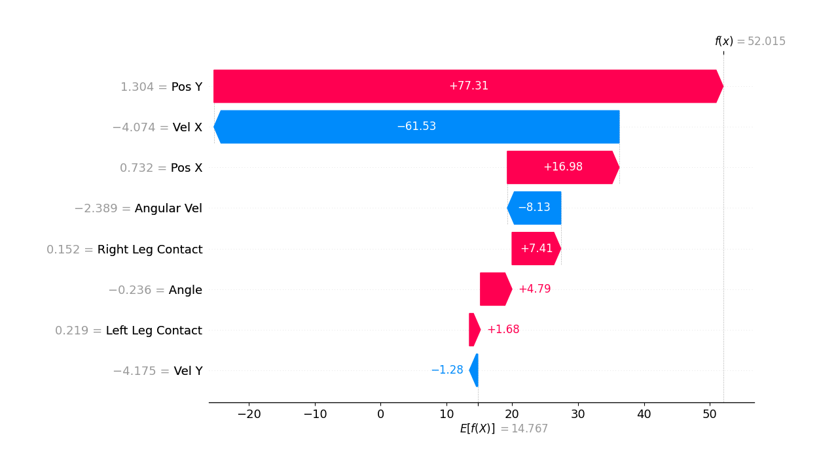
Local SHAP Results
DQN
A2C
PPO

Slide 14
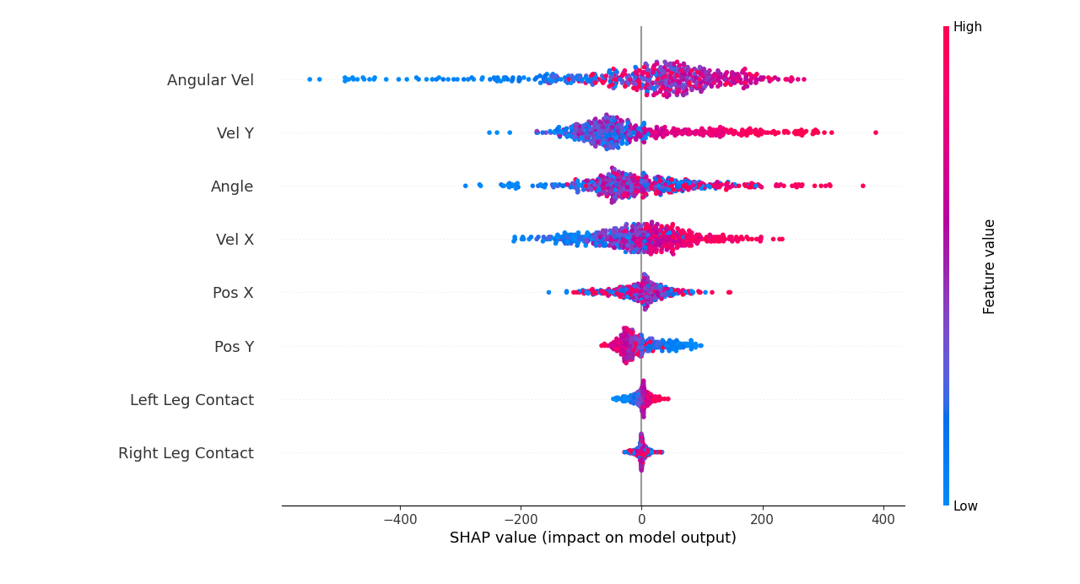
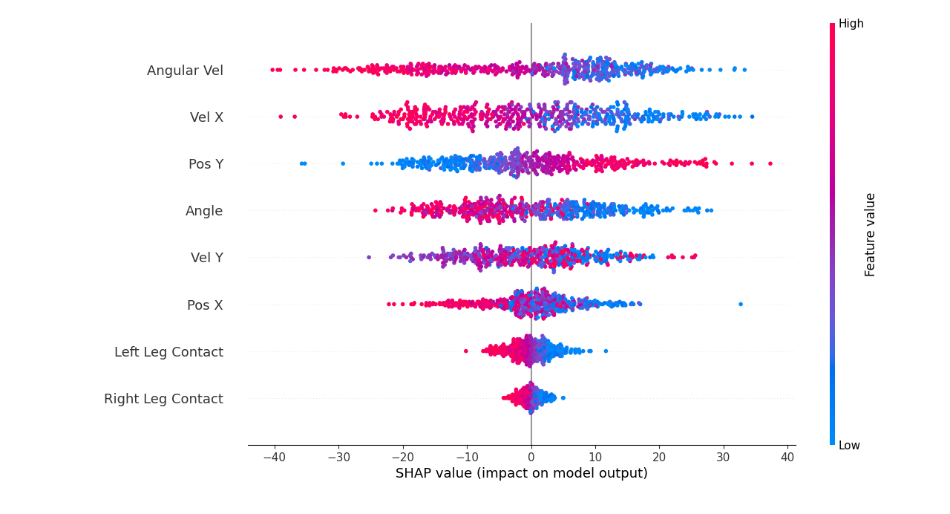
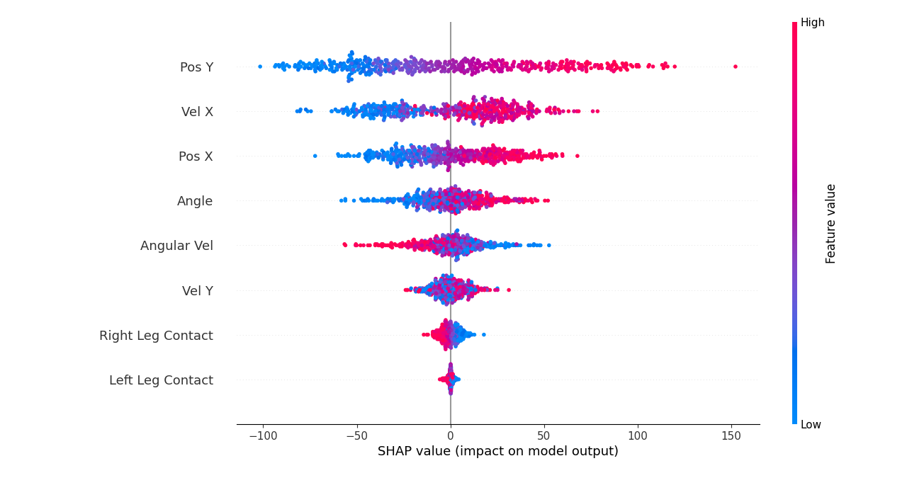
Global SHAP Results
DQN
A2C
PPO

Slide 15
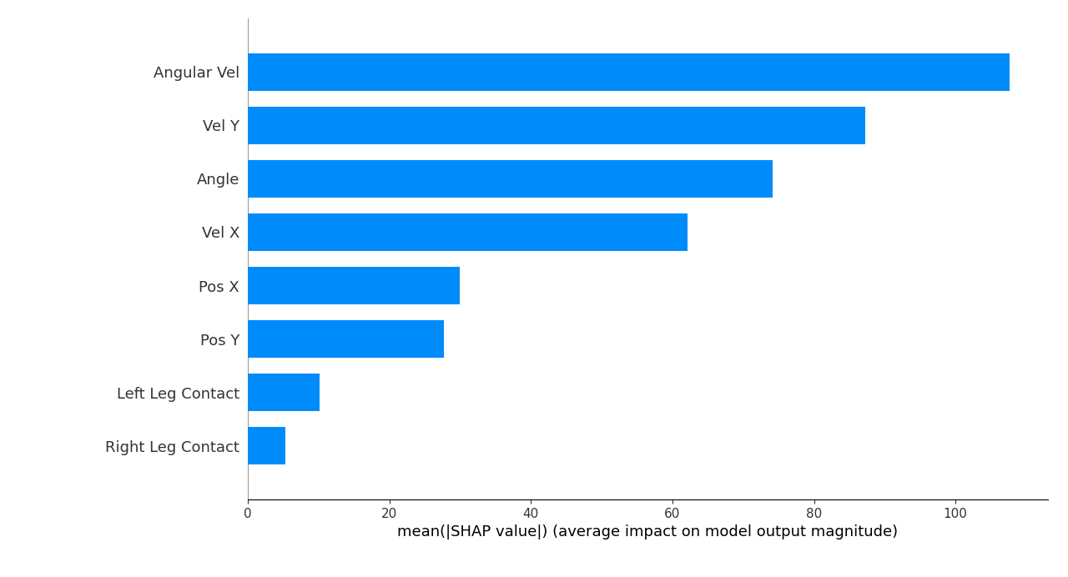
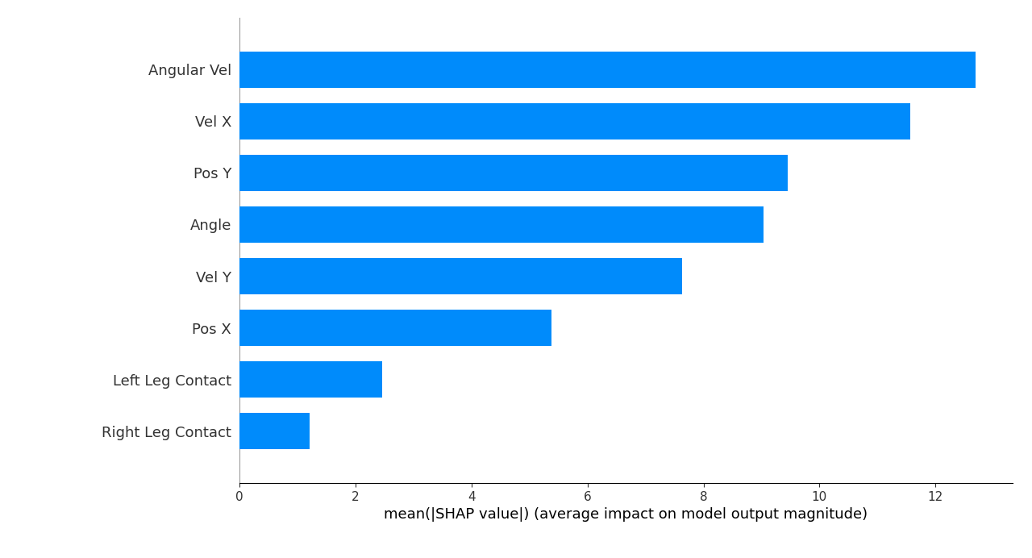
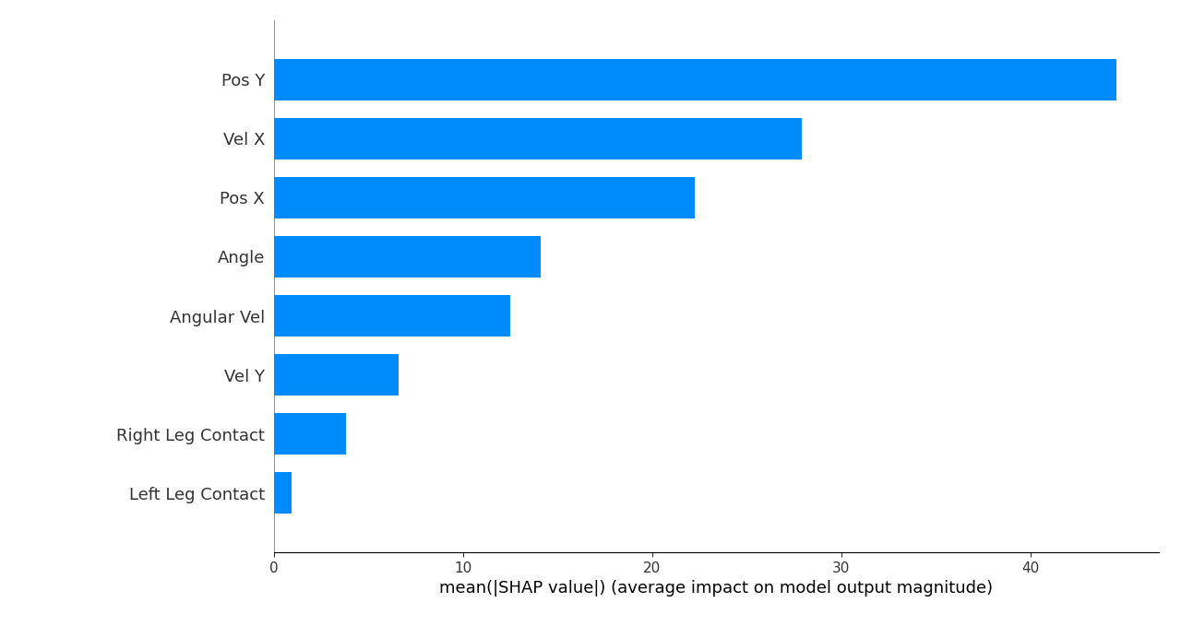
Global SHAP Results
DQN
A2C
PPO

